Slide 1

Intro to Machine Learning
Presented by Undergraduate Researchers in Data

Slide 2
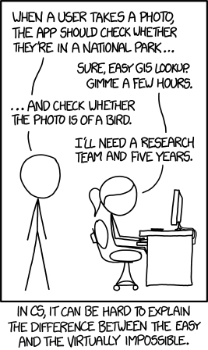
What is machine learning?
“The ability for computers to learn without explicitly being programmed.” - Arthur Samuel, 1959
Different than rule-based paradigm employed in most modern programming projects.
Algorithms that learn from and make predictions on data through a model constructed from sample inputs.
https://xkcd.com/1425/

Slide 3
How is it applied?
Machine learning is used heavily in a wide range of application areas
Language processing, computer vision, recommendation systems, search engines, autonomous vehicles, predictive analytics, etc.
Examples:
Healthcare - determine genes associated with a particular disease, or make diagnoses based on medical image techniques.
Business - predict conversion rate based on customer characteristics, or analyze a large set of user reviews to determine sentiment.
Finance - Detect fraud across millions of transactions, or predict and execute stock market trades.

Slide 4
How is it different from statistics?
Statistics focuses more heavily on assessing underlying assumptions, quantifying confidence and uncertainty, and inferring things about the processes it is attempting to model.
Focus on drawing conclusions from data.
Machine learning relies on brute-force accuracy in prediction of test data without being as concerned as to why.
Focus on solving complex computational tasks.
However, in practice, there can be overlap, and most ML models are statistically-based.

Slide 5
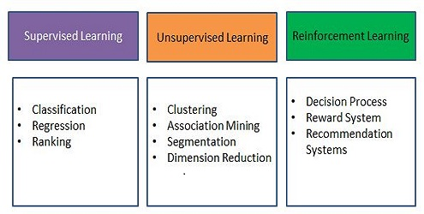
Types of machine learning
Supervised
Correct labels are fed to algorithm to learn off of
Unsupervised
Correct labels are not supplied; computer must generate its own
Other
Reinforcement learning
Semi-supervised learning
Deep learning
http://www.kdnuggets.com/wp-content/uploads/machine-learning-applications.jpg

Slide 6
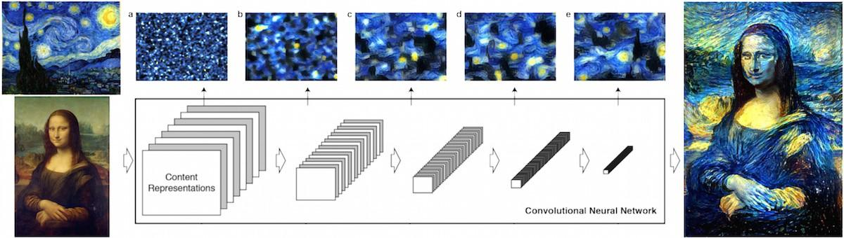
Deep Learning Example
Picture or diagram
https://cdn-images-1.medium.com/max/1200/1*MEX72qFsXQSpBTsj2jC_8w.jpeg

Slide 7
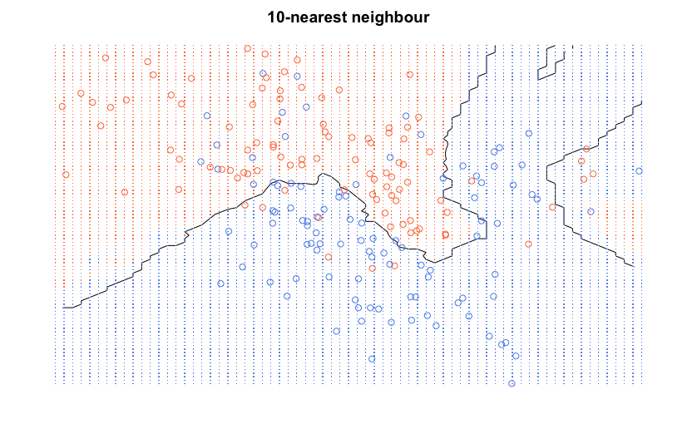
Supervised algorithm - K nearest neighbors
Goal: Determine the classification of a point
Task: Apply algorithm to a multi dimensional feature space each with a class label. Find K number of points near point of interest and the majority label found is used to classify the point of interest.
Method: Determine the distance metric, most commonly used is Euclidean distance function
Examples adapted from ISLR and ESL
Notes:
Training algorithm on labeled training data

Slide 8
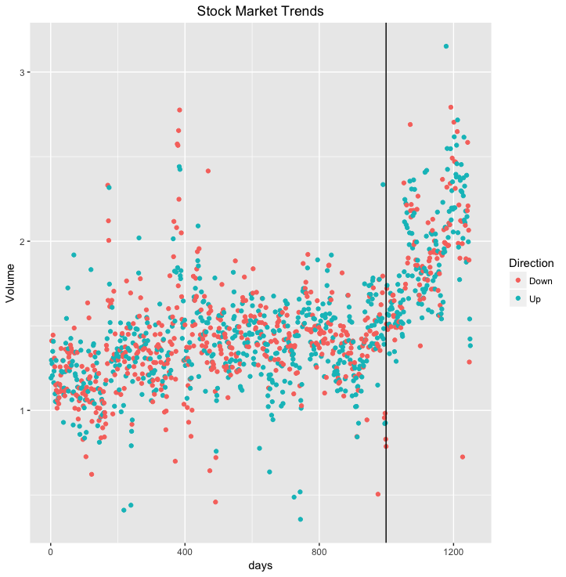
S&P 500
Load Smarket data and Knn package
library(ISLR)
attach(Smarket)
library(class)
Create training and validation set
train.X=cbind(Lag1,Lag2)[train,]
test.X=cbind(Lag1,Lag2)[!train,]
train.Direction=Direction[train]
Apply KNN
set.seed(1)
knn.pred=knn(train.X,test.X,train.Direction,k=1)
knn.pred=knn(train.X,test.X,train.Direction,k=3)
ggplot(Smarket, aes(x= c(1:1250), y= Volume,colour = Direction)) + geom_point() + labs(x= "days", title = "Stock Market Trends") +theme(plot.title = element_text(hjust = 0.5)) + geom_vline(xintercept = 999, linetype == 4)
Examples adapted from ISLR and ESL

Slide 9
KNN Performance on S & P data
Create a confusion matrix
table(knn.pred,Direction.2005)
 | Down | Up
Down | 48 | 54
Up | 63 | 87
Calculate the percentage of knn predictions that match the actual direction in 2005
mean(knn.pred==Direction.2005)
KNN labels matched the actual direction in 2005 53% of the time. Little bit better than a coin flip !

Slide 10
When should you use KNN?
KNN is nonparametric and makes no assumptions about the data, and can be used when you want to predict labels
It is simple to implement
Flexible to add features and change distance matrix
Can be extended to handle multi class cases
With enough training data,it can perform reasonably well
KNN is a popular data mining technique with a wide variety of applications in situations making use of classification and regression
Used for feature extraction in the field of computer vision
Computation pipeline for face recognition, fingerprint detection
Stock market forecasting
Uncover patterns in market trends
Planning investment strategies
Identify the best time to purchase stocks
Medicine
Predict re-occuring adverse events using demographic data
Identify the risk factors based on clinical and demographic variables

Slide 11
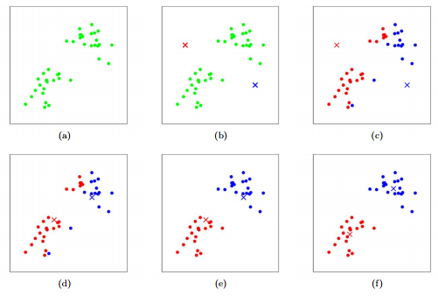
Unsupervised algorithm - k means
Task: find natural groups or clusters in data. Must have cohesiveness between clusters.
Method: plot continuous variables in vector space. Define distance metric to judge how similar observations are.
Goal: minimize within-cluster variation and maximize between-cluster variation.
http://stanford.edu/~cpiech/cs221/img/kmeansViz.png

Slide 12
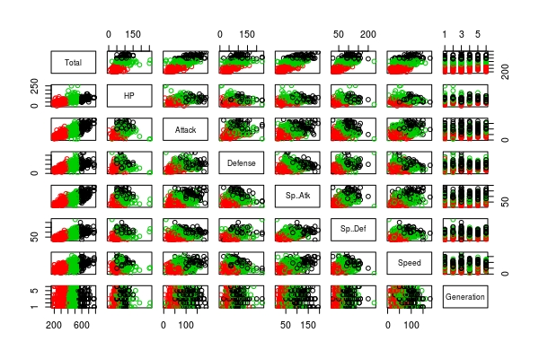
Pokemon Clusters
poke <- read.csv("Pokemon.csv")
#remove all factor variables
kmeans.pred <- kmeans(poke, 3, nstart = 20)
plot(poke, col = kmeans.pred$cluster)

Slide 13
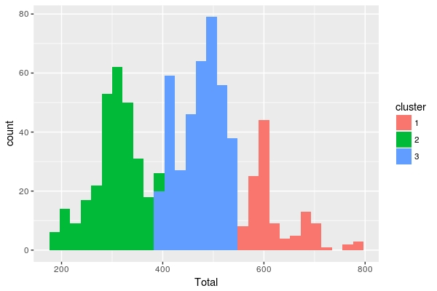
Pokemon Clusters
poke$cluster <- as.factor(kmeans.pred$cluster)
ggplot(poke, aes(Total, fill=cluster)) + geom_histogram()

Slide 14
When should you use k means?
K means is a useful algorithm when you have unlabelled, continuous data that you wish to create groupings for.
Market segmentation: place customers into unique groups, then market to them differently based on their characteristics.
Information retrieval: group search returns in a meaningful way.
Epidemiology: identify progression of a disease geographically.
City planning: identify groups of houses based on their type, value, and location.
Using feature engineering, k means can be applied to many different types of data.
Normalize numeric results so they are all on same scale.
Make ordinal factor variables numeric, or transform into binary values using hot encoding.
Adapted from slide by Gordon Anderson, UMass Amherst

Slide 15
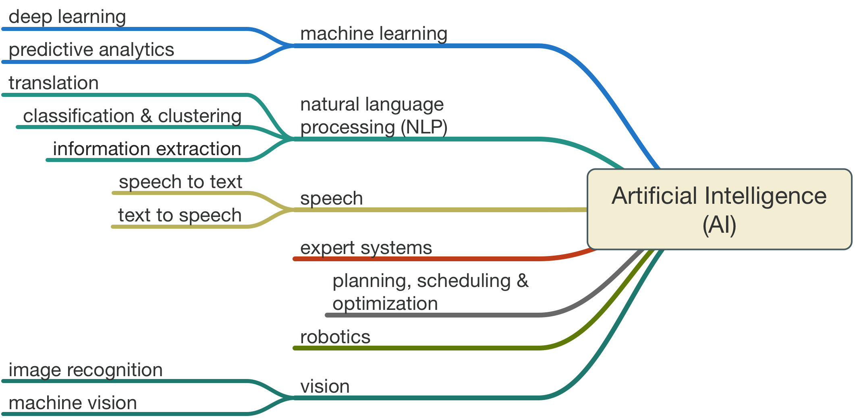
Conclusion
Due to modern increases in data availability and computing power, machine learning and artificial intelligence are poised to make a huge impact in the 21st century.
https://www.codeproject.com/KB/AI/1182210/Def.png

